Slide 1
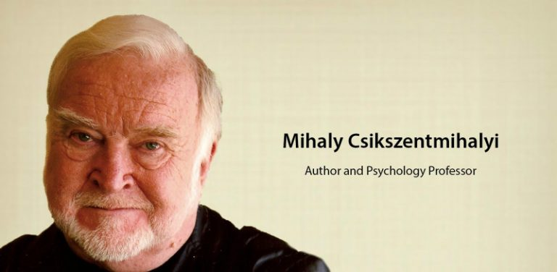
FLOW
Notes:
https://www.pursuit-of-happiness.org/science-of-happiness/happiness-quiz/

Slide 2
Who is Mihaly Csikszentmihalyi?
Mihaly Csikszentmihalyi, considered one of the co-founders of positive psychology, was the first to identify and research flow.
From his own experiences as a prisoner during World War II , from witnessing the pain and suffering from many people around him during this time, he developed a curiosity about happiness and being content with life.
Notes:
Me-High Cheek-Send-Me-high

Slide 3
He observed how many people were unable to live a life of contentment after their jobs, homes, security, etc, were taken from them during the war.
After the war, he read philosophy and took an interest in art and religion as a means to seek an answer to the question, what creates a life worth living?
Notes:
https://www.pursuit-of-happiness.org/science-of-happiness/happiness-quiz/

Slide 4
Beyond each person’s set point of happiness, there is a level of happiness over which each individual has some degree of control.
Through research, Csikszentmihalyi began to understand that people were their most creative, productive, and happy when they are in a state of flow.

Slide 5
Csikszentmihalyi interviewed athletes, musicians, and artists because he wanted to know when they experienced optimal performance levels. He was also interested in finding out how they felt during these experiences.
Csikszentmihalyi developed the term “flow state” because many of the people he interviewed described their optimal states of performance as instances when their work simply flowed out of them without much effort.

Slide 6
Flow is……..
“A state in which people are so involved in an activity that nothing else seems to matter; the experience is so enjoyable that people will continue to do it even at great cost, for the sheer sake of doing it.”
– Csikszentmihalyi, 1990

Slide 7
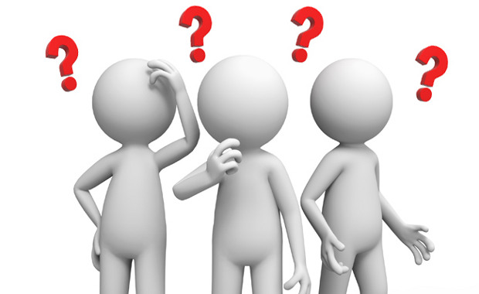
What Happens in the Brain During Flow?

Slide 8
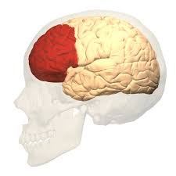
According to Dietrich, it has been associated with decreased activity in the prefrontal cortex.
Notes:
This temporary inactivation of the prefrontal area may trigger the feeling of distortion of time, loss of self-consciousness, and loss of inner-critic.

Slide 9
The state of flow has been rarely investigated from a neuropsychological perspective but is a growing interest.
Moreover, the inhibition of the prefrontal lobe may enable the implicit mind to take over, resulting in more brain areas to communicate freely and engage in a creative process.
In other research, it’s also hypothesized that the flow state is related to the brain’s dopamine reward system.

Slide 10
Microflow Activities
Social:
  unnecessary talking and joking with other people, browsing shops, visiting galleries.
Kinesthetic:
  involves all those activities that involve primarily body movements e.g. touching, fiddling with objects, walking, pacing, running and any games or physical activities engaged in alone.

Slide 11
Imagining:
  daydreaming, humming, singing, playing music in one's head.
Attending:
  all the passive forms of spectatorship such as reading a book, watching people walk down the street, watching television

Slide 12
Flow: Passive vs. Active
Passive
Little effort required
e.g. Watching TV
Active
More effort required
e.g. Sport, Reading, Painting, Gaming

Slide 13
The 8
Characteristics of
Flow

Slide 14
Complete concentration on the task
Clarity of goals and reward in mind and immediate feedback
The experience is intrinsically rewarding
Effortlessness and ease
There is a balance between challenge and skills
Losing in self-conscious thoughts
There is a feeling of control over the task
Transformation of time (speeding up/slowing down)

Slide 15
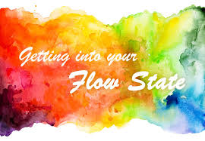
How to Get Into The Flow?

Slide 16
It’s important to note that one can’t experience flow if other distractions disrupt the experience.
Thus, to experience this state, one has to stay away from the attention-robbers in our modern fast-paced life.

Slide 17
A first step would be to dump your smartphone

Slide 18
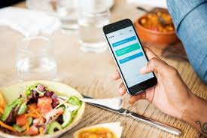

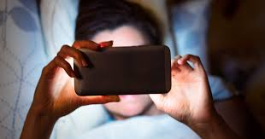

Slide 19
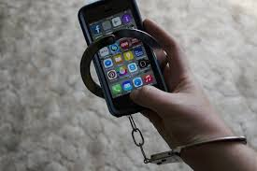

Slide 20
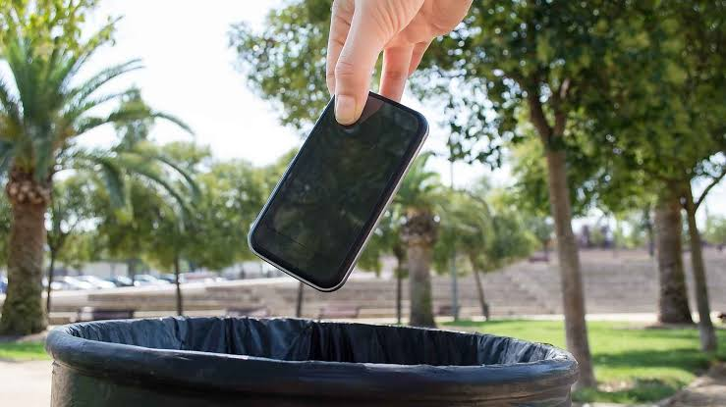

So dump your smartphone
Phone should not control you….
You have to have a control over your phone

Slide 21
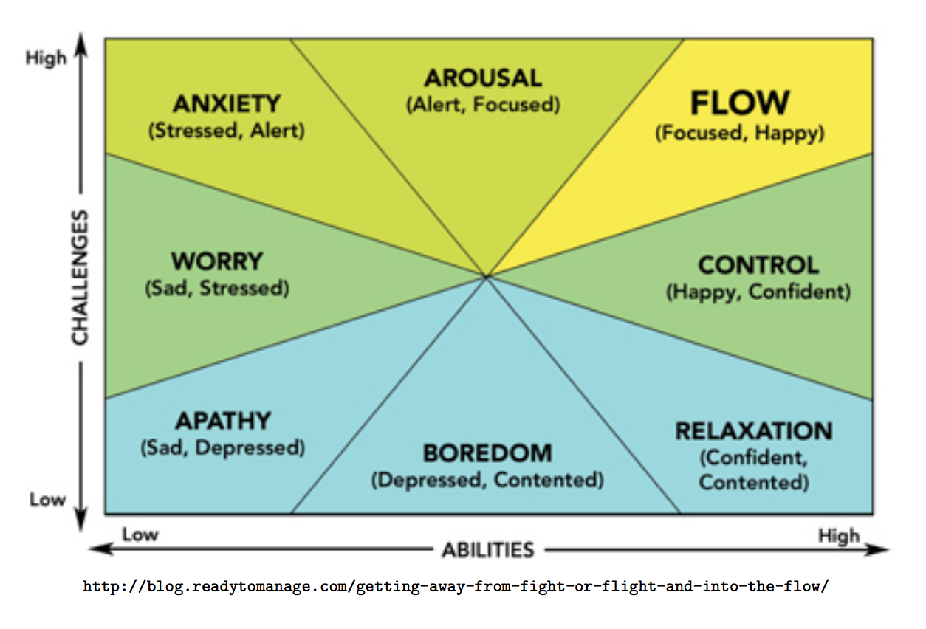
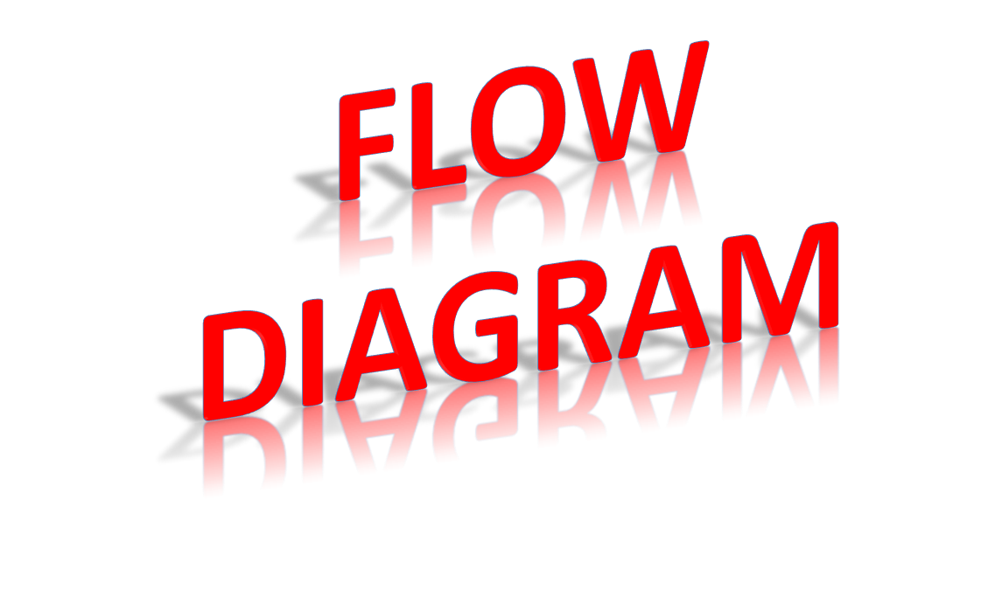
Notes:
Apathy: lack of interest, enthusiasm, or concern.

Slide 22
Also, the balance of perceived challenges and skills are important factors.
On the one hand, when a challenge is bigger than one’s level of skills, one becomes anxious and stressed.
On the other hand, when the level of skill exceeds the size of the challenge, one becomes bored and distracted.

Slide 23
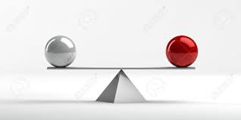
“Inducing flow is about the balance between the level of skill and the size of the challenge at hand.”

Slide 24
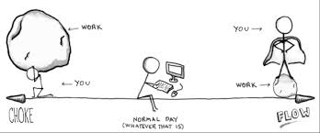

Slide 25
Flow occurs when your skill level and the challenge at hand are equal.

Slide 26
What is The Motivation Behind Your Flow State?
There are two basic types:
  Intrinsic
  Extrinsic.

Slide 27
Intrinsic motivation is where you do something because you love it.
Mihaly Csikszentmihalyi (2013) said the highest intrinsic motivation is “Flow” where self-consciousness is lost, one surrenders completely to the moment and time means nothing.
Notes:
Like when a competent musician plays without thinking, or a surfer catches a great wave and rides it with joy.

Slide 28
Extrinsic motivation is where your motivation to succeed is controlled externally.
Fear motivation
  is not getting into trouble or working hard to earn more money. That type of motivation is short-lived.
Good extrinsic motivation is where you are practicing to get better but you still need a tutor or teacher to validate your efforts.

Slide 29
Summary
It can be prescribed as a key aspect of ‘’eudaimonia’’ in an individual.
Since it is also intrinsically rewarding, the more you practice it, the more you seek to replicate these experiences, which help lead to a fully engaged and happy life.

Slide 30
FLOW
https://video.search.yahoo.com/search/video;_ylt=Awr47Kb3hiZe3BgARyBXNyoA;_ylu=X3oDMTE0Y3FkOGJxBGNvbG8DZ3ExBHBvcwMxBHZ0aWQDQjkzMTdfMQRzZWMDcGl2cw--?p=POSITIVE+PSYCHOLOGY+FLOW+ONLINE+TEST&fr2=piv-web&fr=mcafee#id=12&vid=450c93398443afa005fb5f45816070f6&action=view

Slide 31
https://www.pursuit-of-happiness.org/science-of-happiness/happiness-quiz/

